Slide 1

NETFLIX AI – DRIVEN INSIGHTS
Class Incharge Name:
Dr.A.BANUSHRI
S.PRANOV
22620134

Slide 2

AI - DRIVEN INSIGHTS

Slide 3

PROBLEM STATEMENT
This project involves loading, cleaning, analyzing, and visualizing data from a Netflix dataset. We'll use Python libraries like Pandas, Matplotlib, and Seaborn to work through the project. The goal is to explore the dataset, derive insights, and prepare for potential machine learning tasks.

Slide 4

INTRODUCTION
Netflix, as one of the world’s leading streaming services, offers a vast collection of movies, TV shows, and original content. With its continuous expansion of the content library, analyzing trends and patterns in its catalog provides valuable insights into viewer preferences and the global streaming market. This project aims to clean, analyze, and visualize a dataset comprising Netflix content added between 2008 and 2021.
Using Python, SQL, and Tableau, the project focuses on exploring key aspects such as content type distribution, genre popularity, regional content trends, and rating pattern

Slide 5
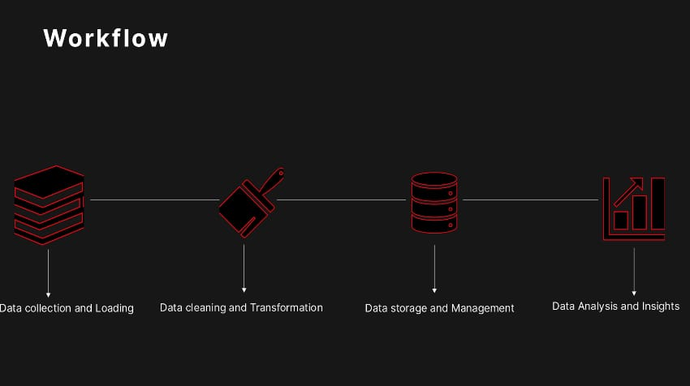

Slide 6

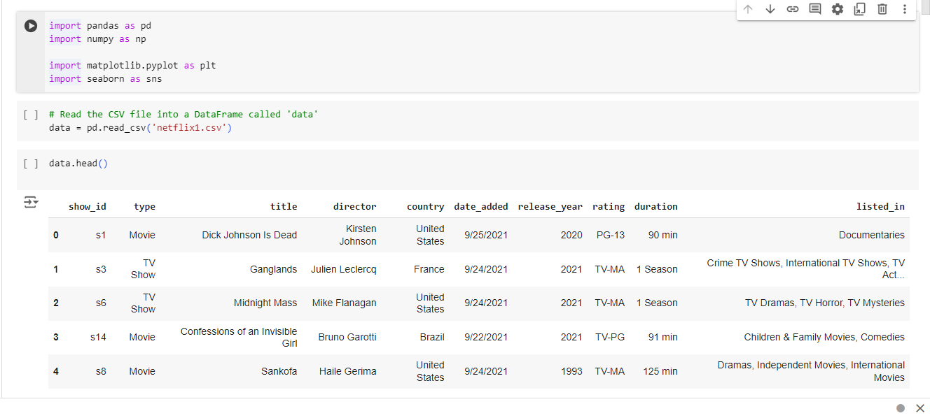
DATA LOADIND AND PROCESSING
Importing the python libraries
Reading the dataset using pandas dataframe
Displaying the dataset using head() function

Slide 7
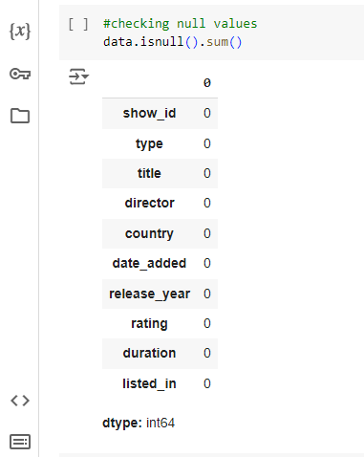
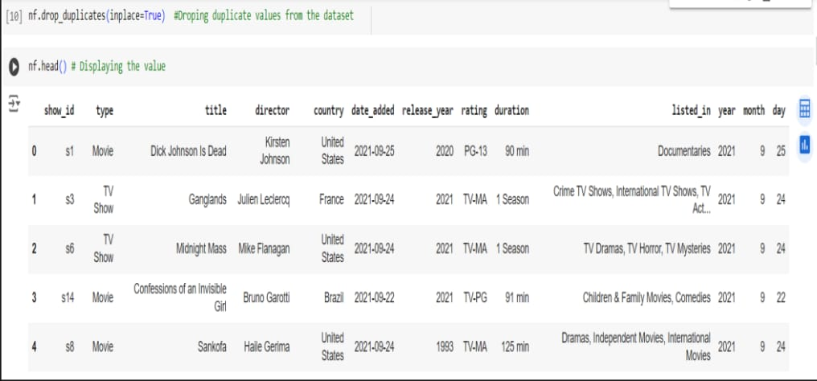
DATA CLEANING PROCESS
1.CHECK THE NULL VALUES IN THE DATASET
2.CHECK THE DUPLICATE VALUES IN THE DATASET

Slide 8
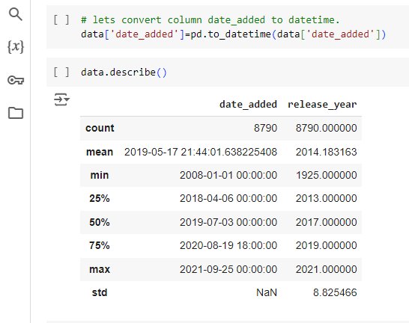
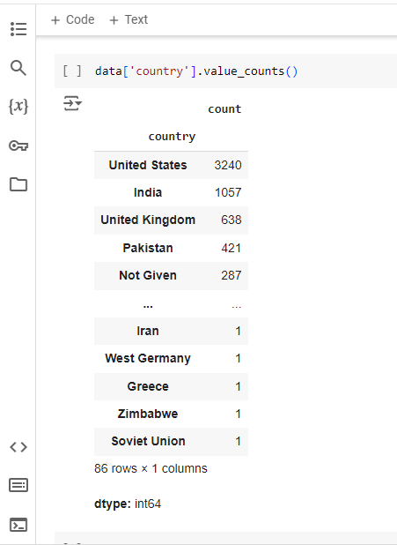
3. UPDATING THE DATE COLUMN
4.UPDATING THE VALUE COUNTS BY COUNTRIES

Slide 9

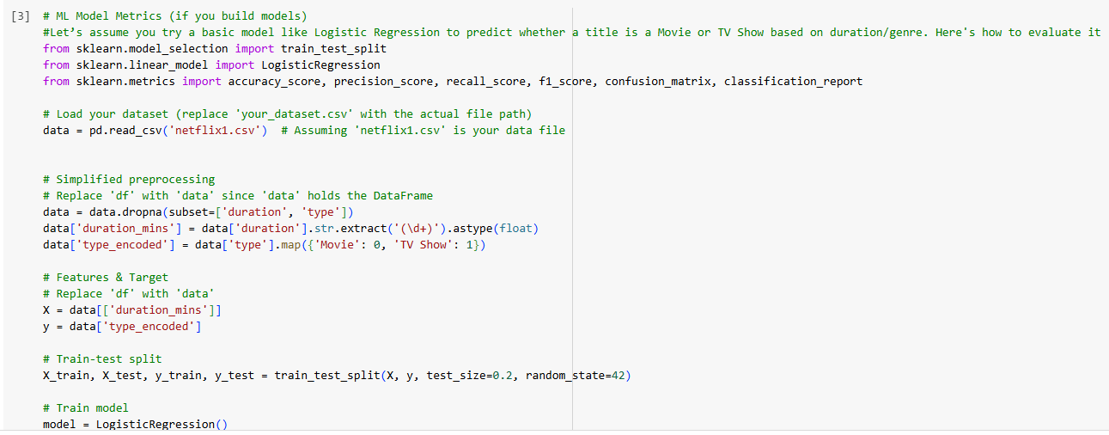
ML Model Metrics

Slide 10
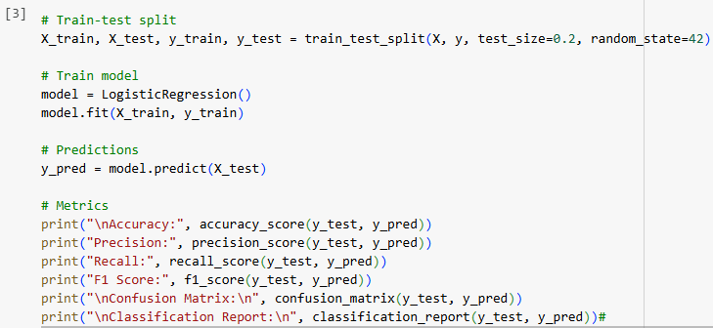
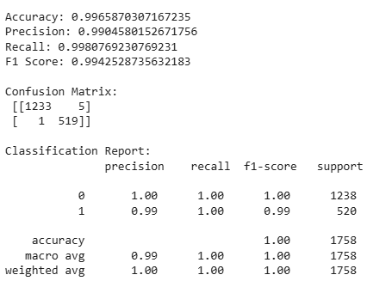

Slide 11
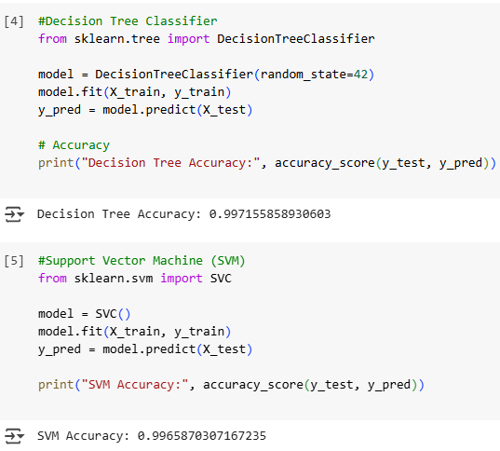
Decision Tree Classifier and Support Vector Machine (SVM)

Slide 12
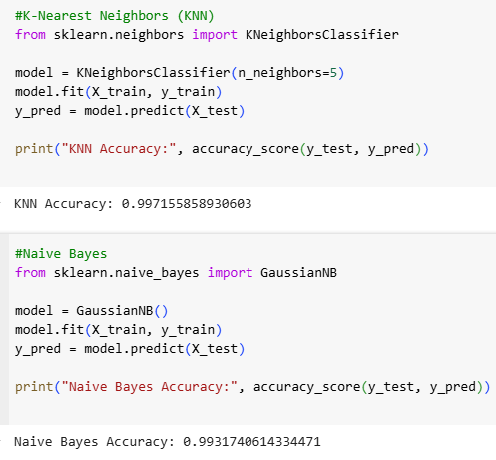
K-Nearest Neighbors (KNN) And Naive Bayes

Slide 13
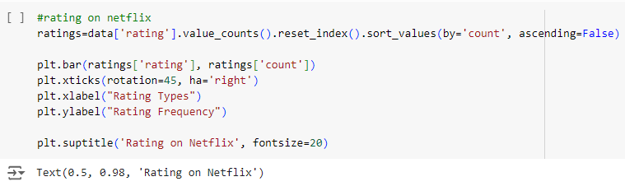
TOTAL RATINGS ON NETFLIX

Slide 14
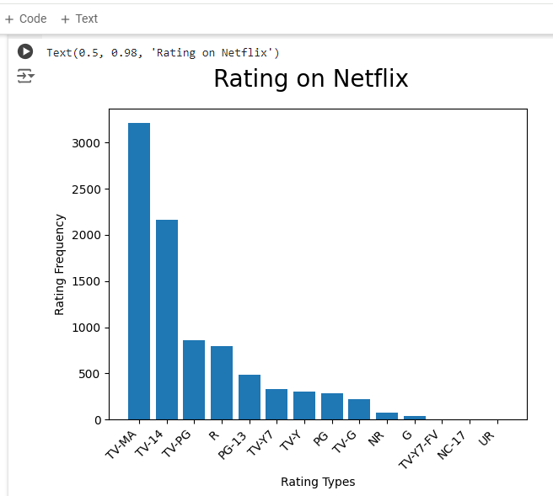
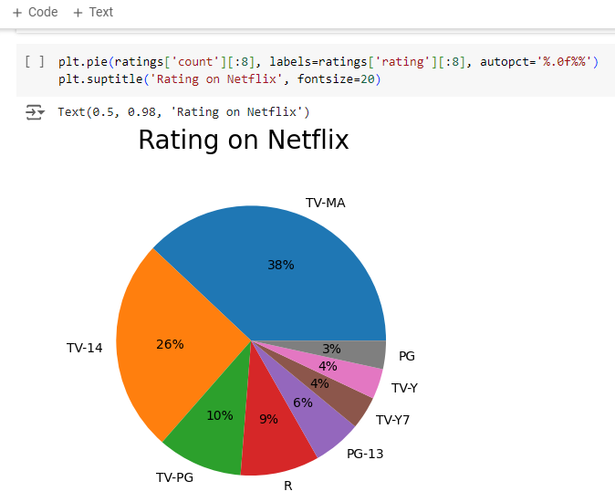

Slide 15
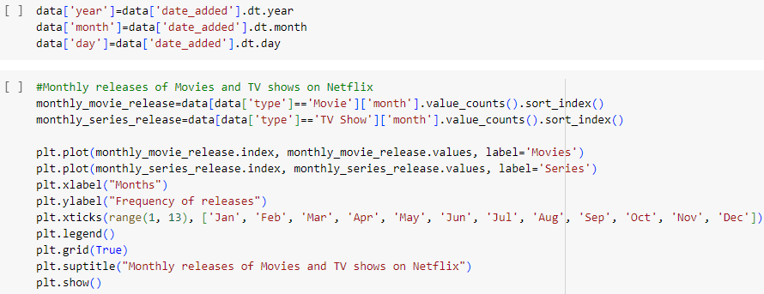
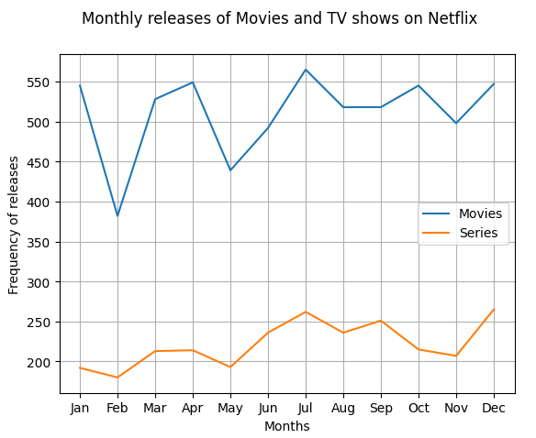
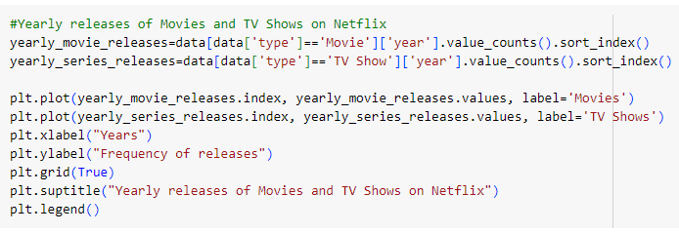
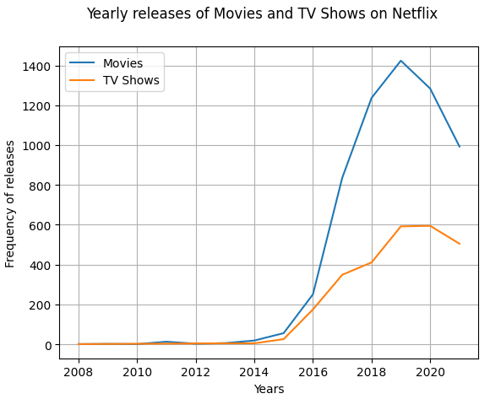
Monthly and yearly releases of movies and tv shows

Slide 16
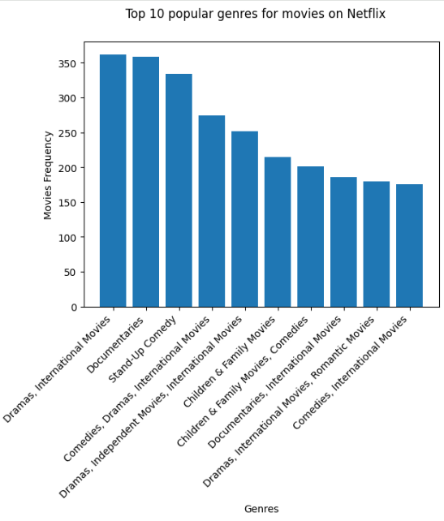
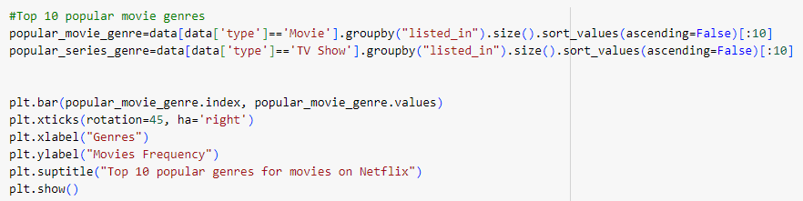
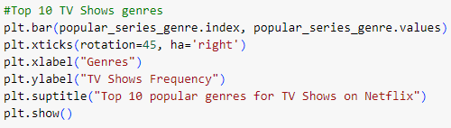
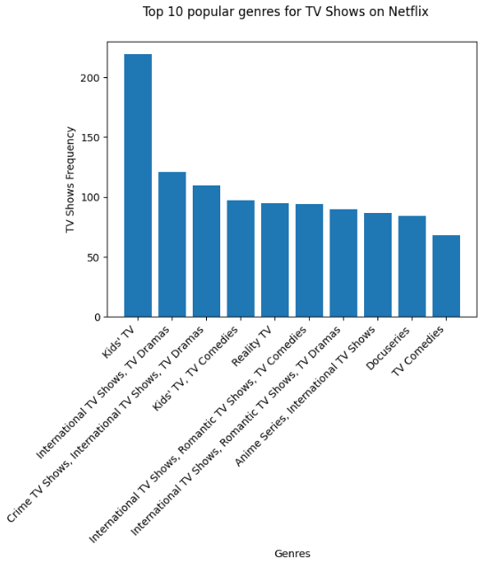
TOP 10 MOVIES AND TV SHOWS GENRES ON NETFLIX

Slide 17
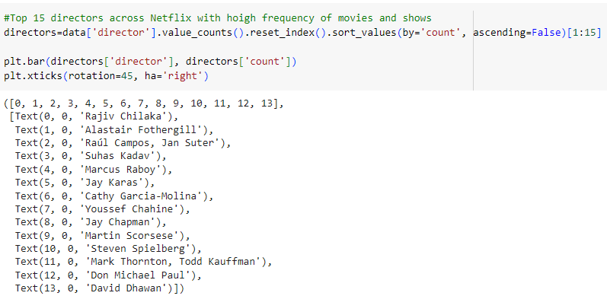
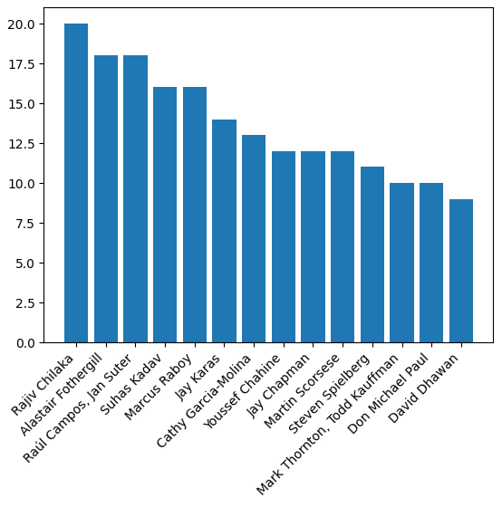
TOP 15 DIRECTORS WITH HIGH FREQUENCY OF MOVIES AND TV SHOWS

Slide 18
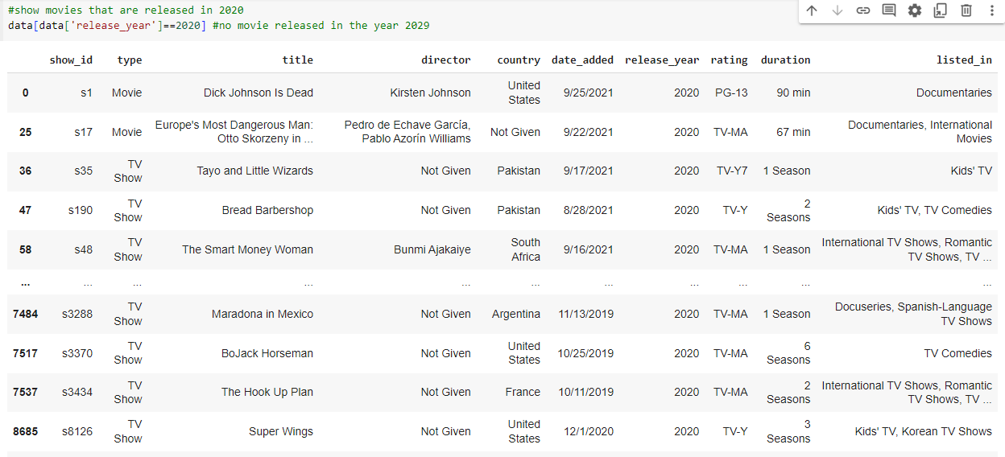
LIST OF MOVIES AND TV SHOWS RELEASED IN THE YEAR 2020

Slide 19
CONCLUSION
This project successfully cleaned, analyzed, and visualized Netflix content data from 2008 to 2021. Key insights included content type distribution, popular genres, regional contributions, and rating patterns. The visualizations highlighted trends in content additions and top contributors, offering valuable perspectives. The cleaned dataset also opens up possibilities for future machine learning applications, such as recommendation systems.

Slide 20

BY
S.PRANOV
22620134

